Slide 1
Introduction to Global Securities Market
国际证券市场简介
College of Software Technology, Zhejiang University
浙江大学软件学院
May 19-20, 2018
Edward Li, CFA, FRM
ecli_99@yahoo.com

Slide 2
Learning Objectives
Through this course the students will understand the fundamental concepts about Mutual Funds Concepts, Operation, Workflow and Investment terminology.
Quiz will be given at the end of class

Slide 3
推荐教材或主要参考书
1.
Name: 美国开放基金
Author: American Bankers Association
Publisher: American Bankers Association
Language: English
Date:
ISBN: 0-89982-359-9
2.
Name: Dictionary of Finance and Investment Terms
Author: John Downes & Jordan Elliot Goodman
Publisher: Barron’s Educational Series, Inc.
Language: English
Date:
ISBN: 0-7641-0790-9

Slide 4
推荐教材或主要参考书
3.
2018 Investment Company Fact Book, 58th Edition

Slide 5
Session 1 Mutual Fund Overview

Slide 6
What is a Mutual Fund?
  Extremely popular over the last 30 years.
  More than 80 million people, or one half of the households in America, invest in mutual funds.
  It’s common knowledge that investing in mutual funds is better than saving in bank for most people.
  Mutual Fund, Hedge Fund, ETFs
  Mutual fund is an investment company that pools the savings of a number of investors who share a common financial goal. The money thus collected is invested into a variety of securities, including stocks, bonds, and money-market instruments.
  Each scheme of a mutual fund can have different characteristics and objectives. Mutual funds issue units to the investors, which represent an equitable right in the assets of the mutual fund.

Slide 7
Basic Concepts
A Mutual Fund is a trust that pools the savings of a number of investors who share a common financial goal.
The money thus collected is then invested in capital market instruments such as shares, debentures and other securities.
The income earned through these investments and the capital appreciation realized are shared by its unit holders in proportion to the number of units owned by them.
Thus a Mutual Fund is the most suitable investment for the common man as it offers an opportunity to invest in a diversified, professionally managed basket of securities at a relatively low cost.

Slide 8
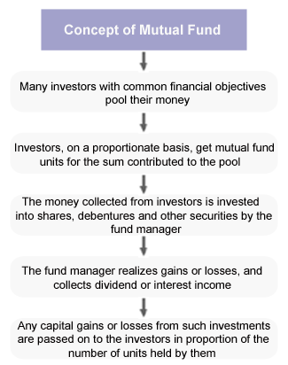
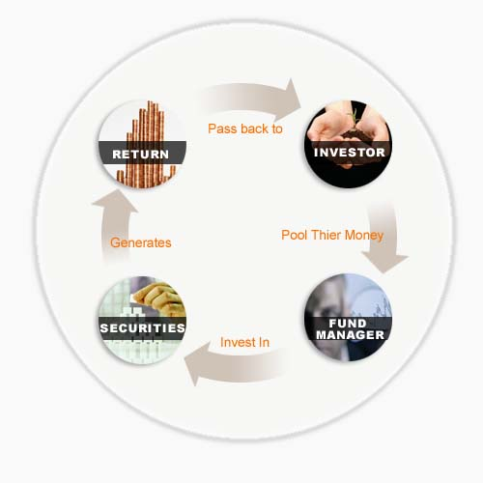
Mutual Fund Cycles

Slide 9
Three ways to get payment from a mutual fund
1) Income is earned from dividends on stocks and interest on bonds. A fund pays out nearly all of the income it receives over the year to fund owners in the form of a distribution.
2) If the fund sells securities that have increased in price, the fund has a capital gain. Most funds also pass on these gains to investors in a distribution.
3) If fund holdings increase in price but are not sold by the fund manager, the fund's shares increase in price. You can then sell your mutual fund shares for a profit.

Slide 10
Advantages of Mutual Funds
Professional Management
Diversification
Economies of Scale
Liquidity
Simplicity
Transparency
Flexibility
Choice of schemes
Tax benefits
Well regulated

Slide 11
Advantages of Mutual Funds
In-class Exercise:
Mutual funds offer investors all the following advantages EXCEPT:
  Professional management
  Tax deferral
  Diversification
  Convenience

Slide 12
Disadvantages of Mutual Funds:
Professional Management - Did you notice how we qualified the advantage of professional management with the word "theoretically"? Many investors debate whether or not the so-called professionals are any better than you or I at picking stocks. Management is by no means infallible, and, even if the fund loses money, the manager still takes his/her cut. We'll talk about this in detail in a later section.
Costs - Mutual funds don't exist solely to make your life easier - all funds are in it for a profit. The mutual fund industry is masterful at burying costs under layers of jargon. These costs are so complicated that in this tutorial we have devoted an entire section to the subject.
Dilution - It's possible to have too much diversification. Because funds have small holdings in so many different companies, high returns from a few investments often don't make much difference on the overall return. Dilution is also the result of a successful fund getting too big. When money pours into funds that have had strong success, the manager often has trouble finding a good investment for all the new money.
Taxes - When making decisions about your money, fund managers don't consider your personal tax situation. For example, when a fund manager sells a security, a capital-gains tax is triggered, which affects how profitable the individual is from the sale. It might have been more advantageous for the individual to defer the capital gains liability.

Slide 13
Frequently Used Terms
Net Asset Value (NAV)
Net Asset Value is the market value of the assets of the scheme minus its liabilities. The per unit NAV is the net asset value of the scheme divided by the number of units outstanding on the Valuation Date.
Sale Price
Is the price you pay when you invest in a scheme. Also called Offer Price. It may include a sales load.
Repurchase Price
Is the price at which a close-ended scheme repurchases its units and it may include a back-end load. This is also called Bid Price.

Slide 14
Frequently Used Terms
Redemption Price
Is the price at which open-ended schemes repurchase their units and close-ended schemes redeem their units on maturity. Such prices are NAV related.
Sales Load
Is a charge collected by a scheme when it sells the units. Also called, ‘Front-end’ load. Schemes that do not charge a load are called ‘No Load’ schemes.
Repurchase or ‘Back-end’ Load
Is a charge collected by a scheme when it buys back the units from the unit holders.

Slide 15
Session 2 Mutual Fund Market

Slide 16
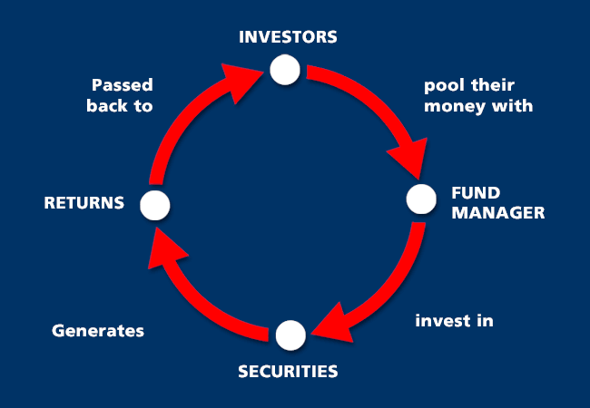
Mutual Fund Operation Flow Chart

Slide 17
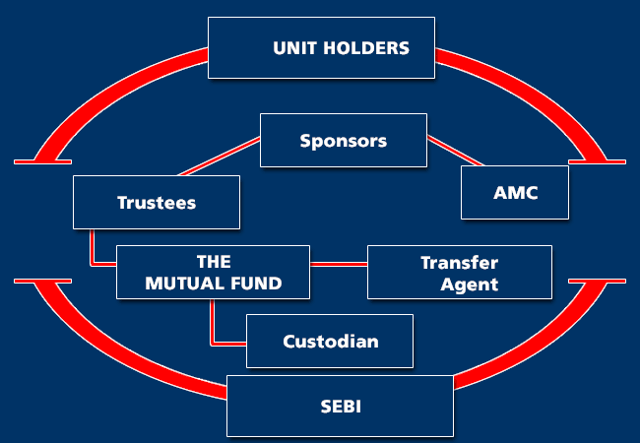
Organization of a Mutual Fund

Slide 18
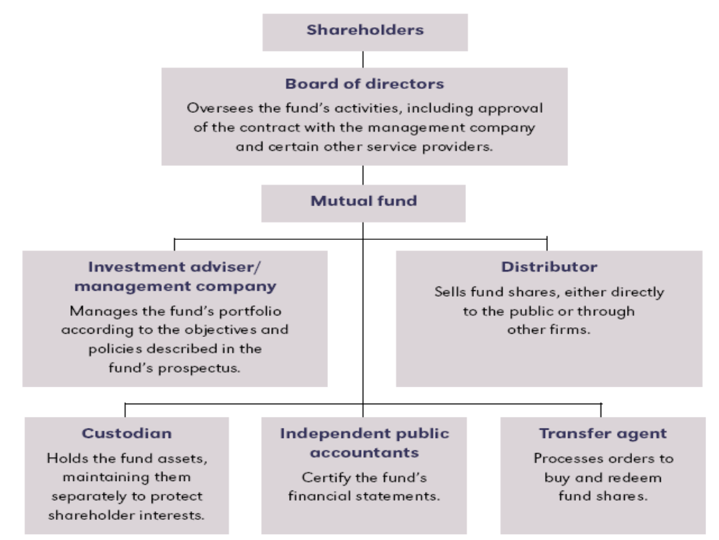
The Structure of Mutual Fund

Slide 19
Mutual Fund Industry
Transfer Agent
  A transfer agent is employed by a mutual fund to conduct recordkeeping and related functions. Transfer agents maintain records of shareholder accounts, calculate and disburse dividends, and prepare and mail shareholder account statements, federal income tax information and other shareholder notices. Some transfer agents prepare and mail statements confirming shareholder transactions and account balances and maintain customer service departments to respond to shareholder inquiries.
Mutual Fund Custodian
  An entity, usually a bank or trust company, which holds and safeguards securities owned by a mutual fund. Such an entity may also act as a transfer agent.

Slide 20
Mutual Fund Industry
Role of Custodian
ABC Trust Company is the Akila Fund’s custodian. ABC Trust’s main function is to:
  Manage the fund’s portfolio
  Insure the fund’s shareholders against investment losses
  Indemnify the fund’s directors in case of legal actions
  Preserve the fund’s physical assets

Slide 21
Mutual Fund Industry
Role of Custodian
The custodian bank of a mutual fund:
  Manages the fund
  Acts as the distributor of the fund
  Holds the fund's cash and securities and performs essential clerical functions but does not manage the fund
  Guarantees investors against any loss that may be incurred if the fund should decline in value

Slide 22
Mutual Fund Industry
Investment Advisor
A fund’s investment advisor may have complete discretion to manage the fund’s portfolio any way it wants as long as the fund outperforms the Dow Jones Industrial Average or some other relevant index specified in the advisor’s contract:
  True
  False

Slide 23
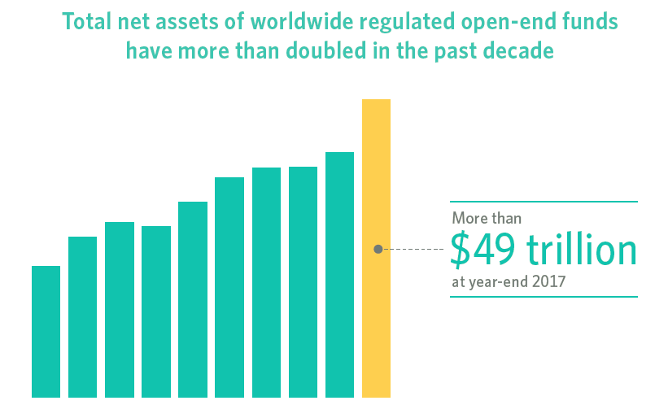
Worldwide Regulated Funds

Slide 24
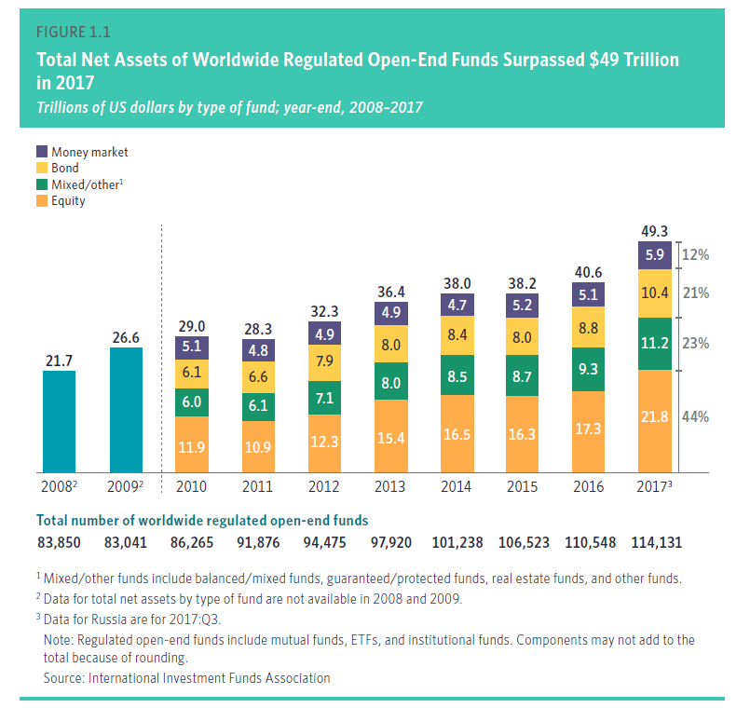
Worldwide Regulated Funds

Slide 25
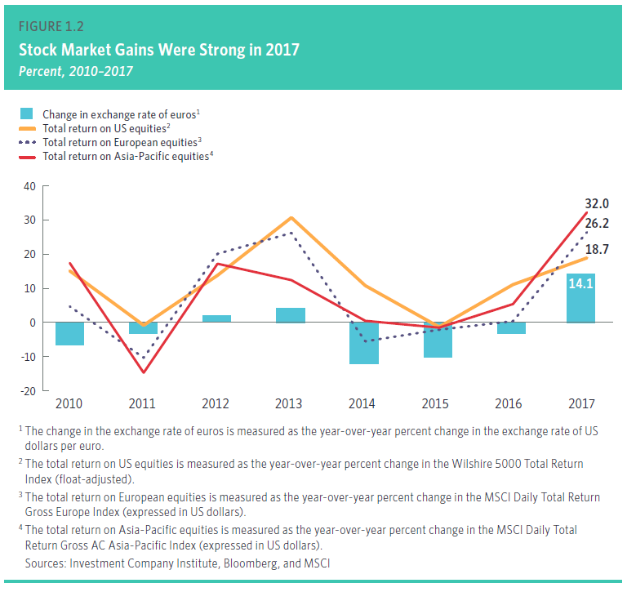
Worldwide Regulated Funds

Slide 26
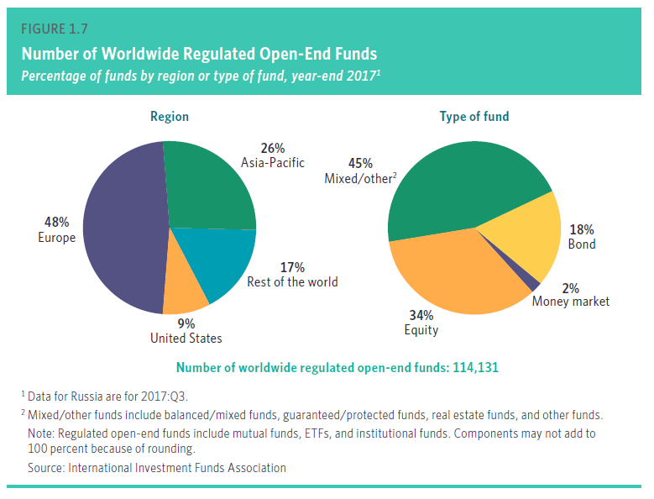
Worldwide Regulated Funds

Slide 27
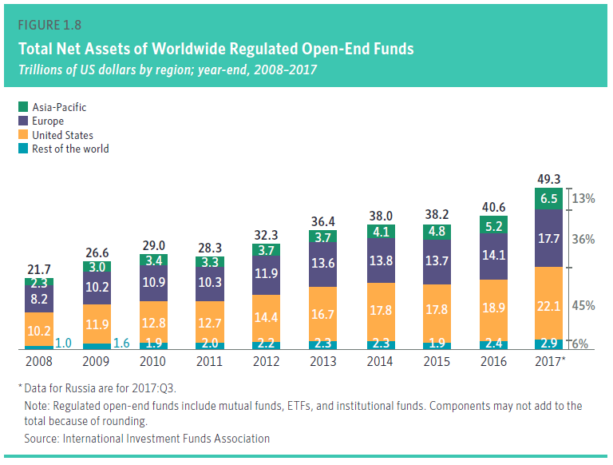
Worldwide Regulated Funds

Slide 28
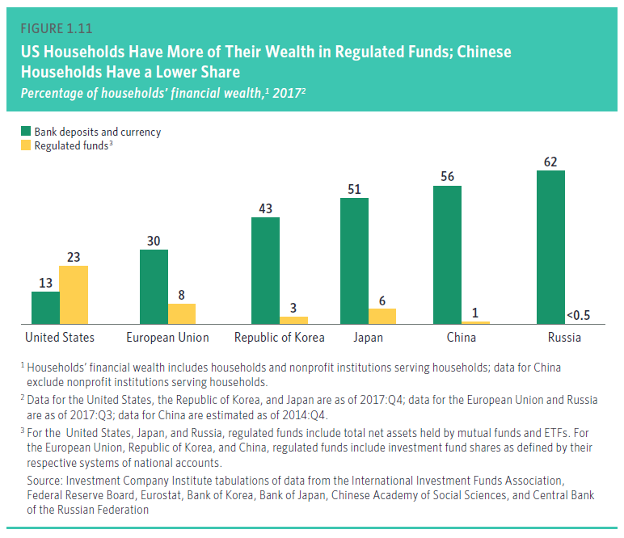
Worldwide Regulated Funds

Slide 29
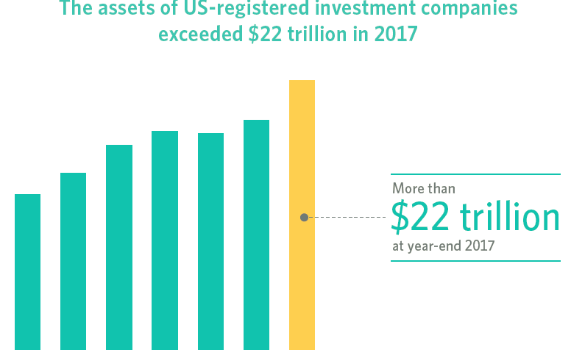
U.S. Mutual Fund Industry

Slide 30
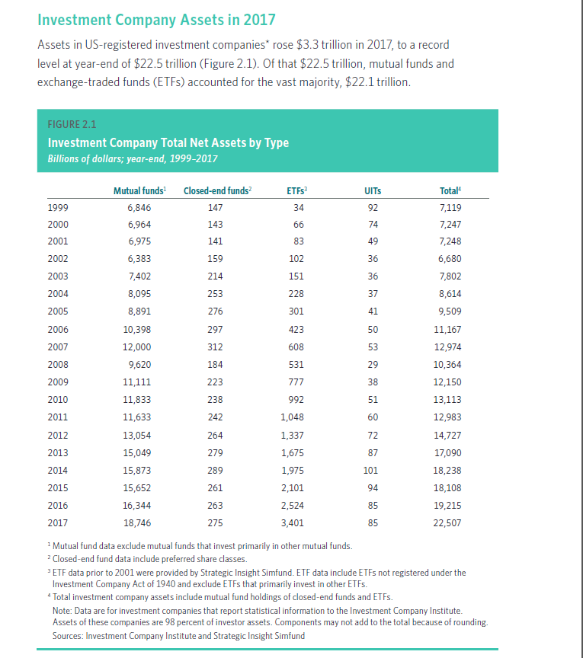
U.S. Mutual Fund Industry

Slide 31
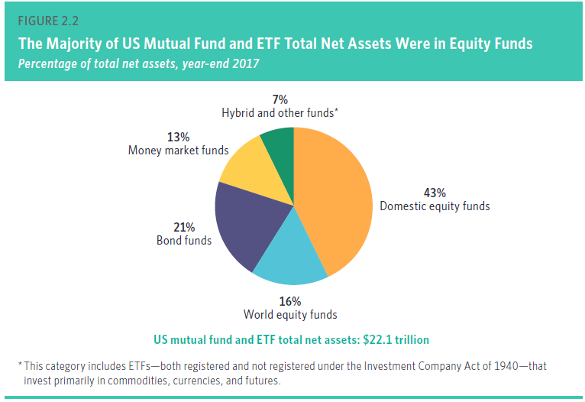
U.S. Mutual Fund Industry

Slide 32
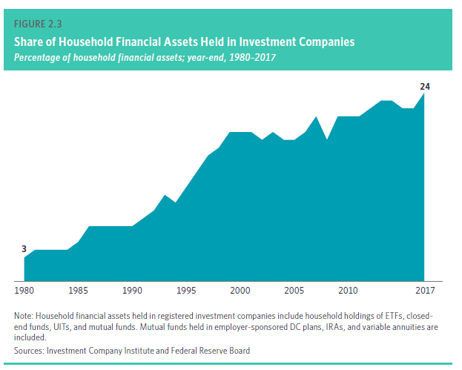
U.S. Mutual Fund Industry

Slide 33
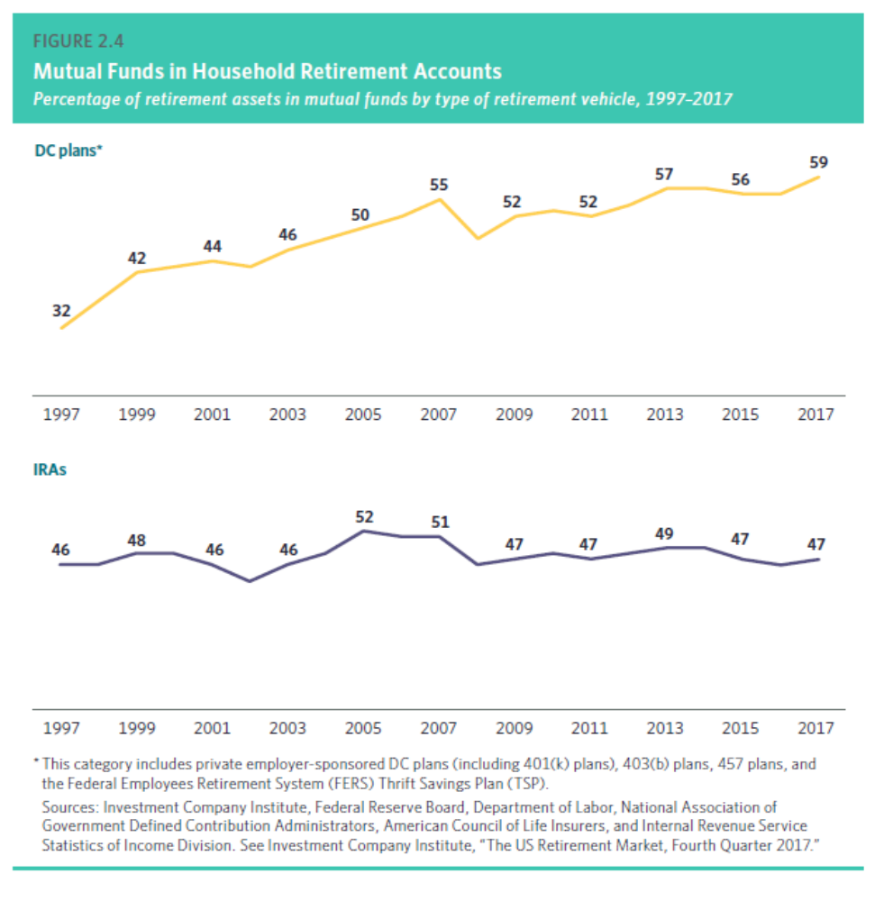
U.S. Mutual Fund Industry

Slide 34
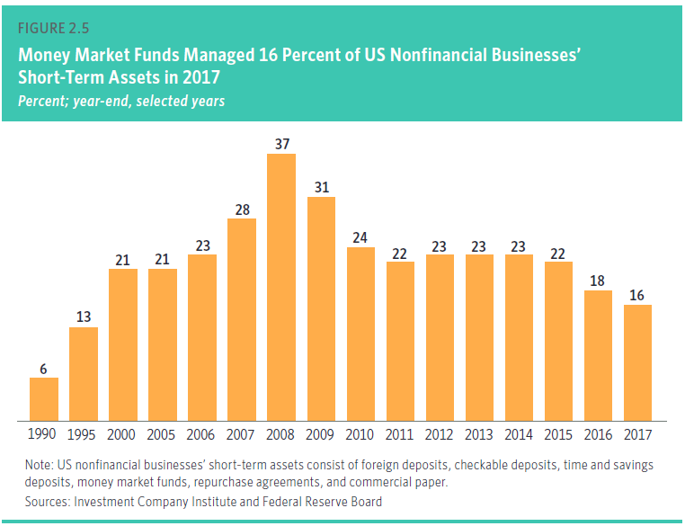
U.S. Mutual Fund Industry

Slide 35
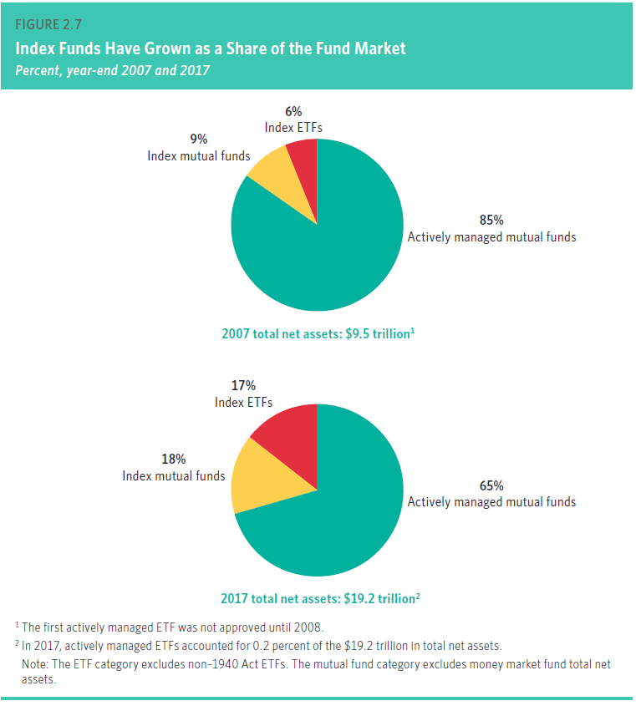
U.S. Mutual Fund Industry

Slide 36
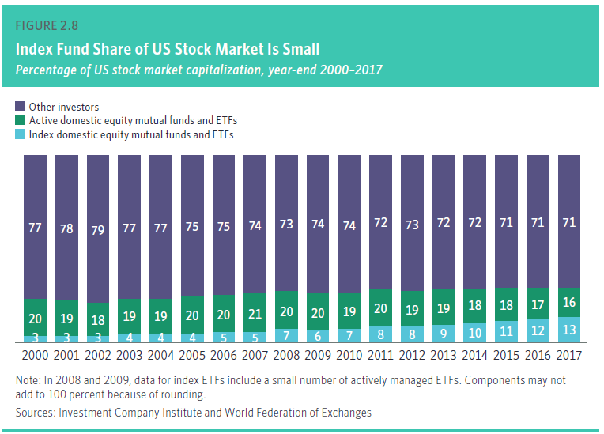
U.S. Mutual Fund Industry

Slide 37
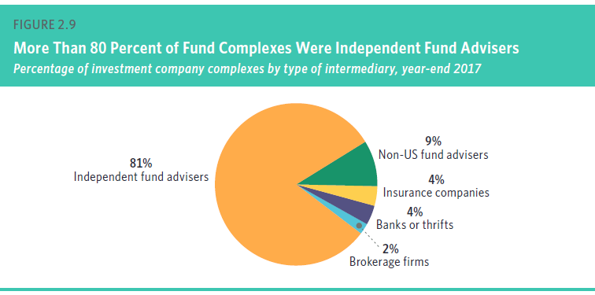
U.S. Mutual Fund Industry

Slide 38
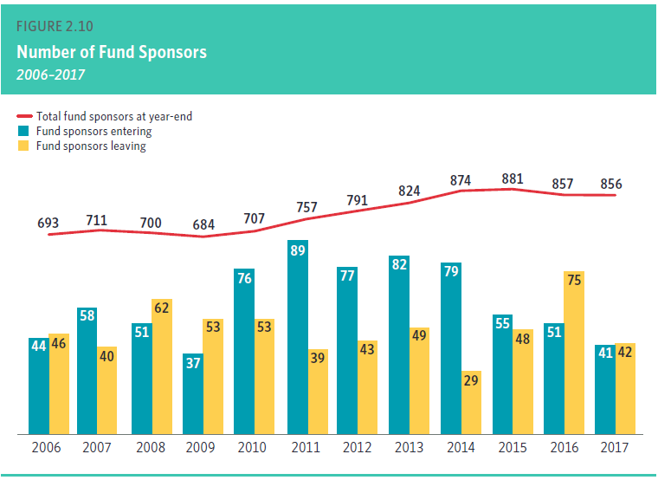
U.S. Mutual Fund Industry

Slide 39
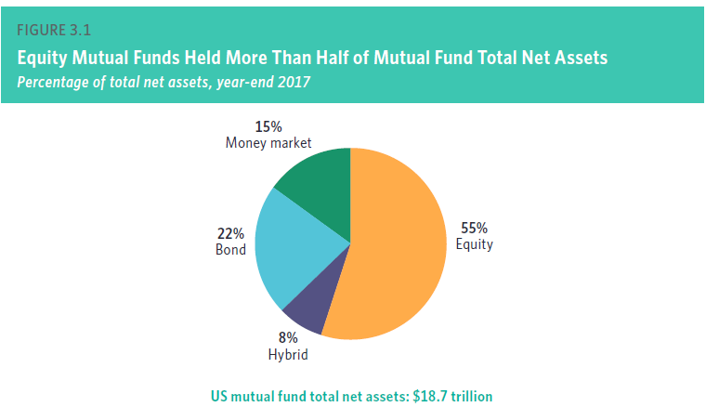
U.S. Mutual Fund Industry

Slide 40
Mutual Fund Industry
In-class Exercise:
The CEO of the Happy Widows Income Fund wants to change its investment objective from income to growth and income. In order to do this, she will need to obtain the approval of:
  A majority of the fund’s non-interested directors
  All of the members of the fund’s board of directors
  A majority of the fund’s outstanding shares
  The fund’s investment advisor and custodian

Slide 41
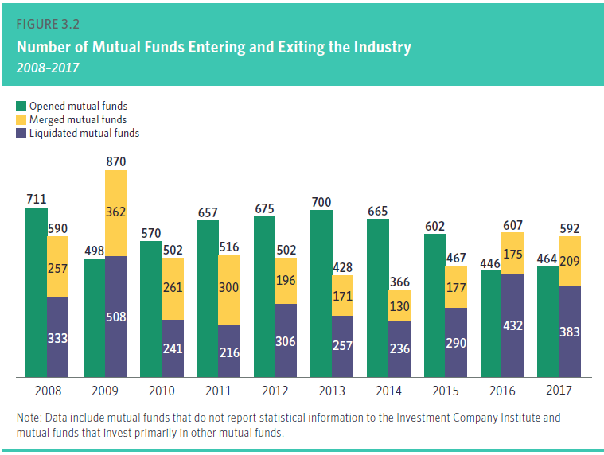
Recent Mutual Fund Trends

Slide 42
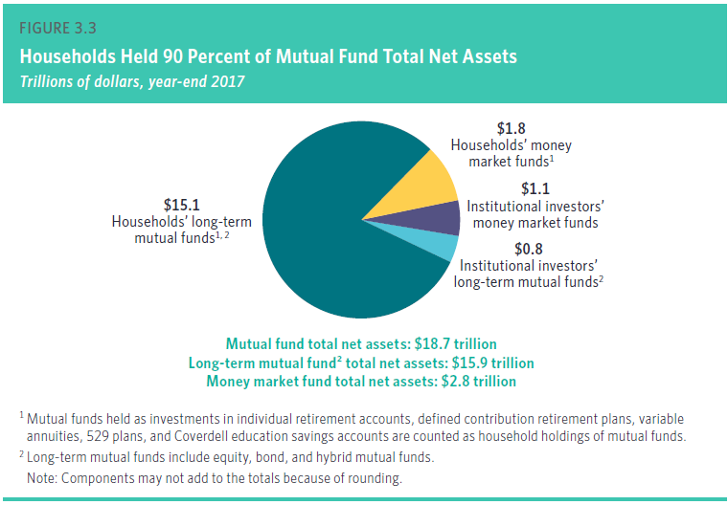
Recent Mutual Fund Trends

Slide 43
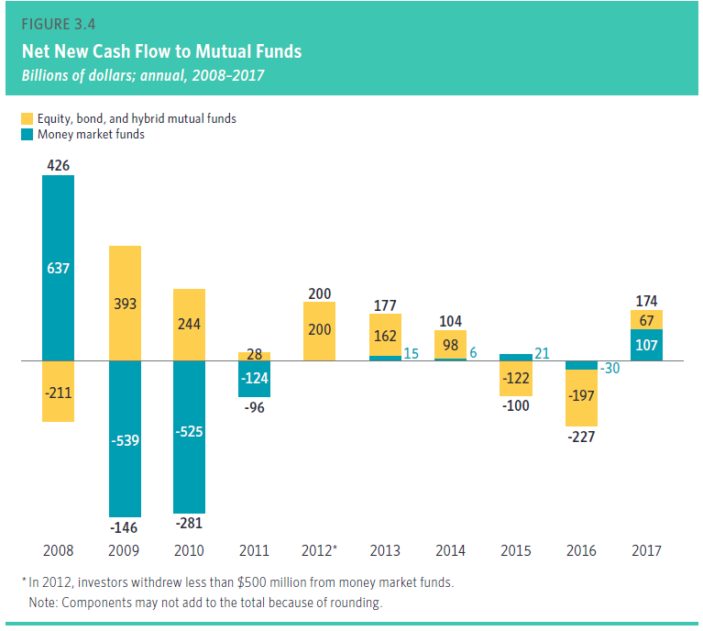
Recent Mutual Fund Trends

Slide 44
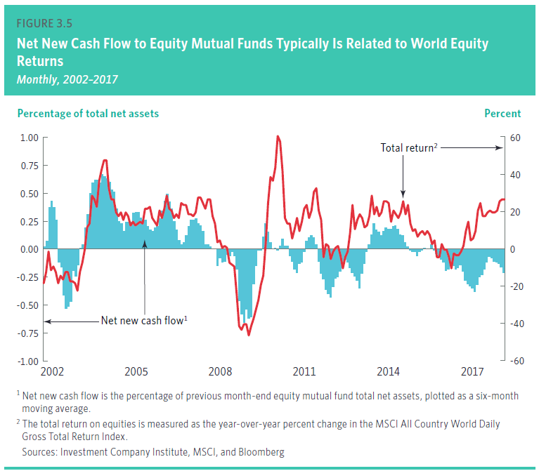
Recent Mutual Fund Trends

Slide 45
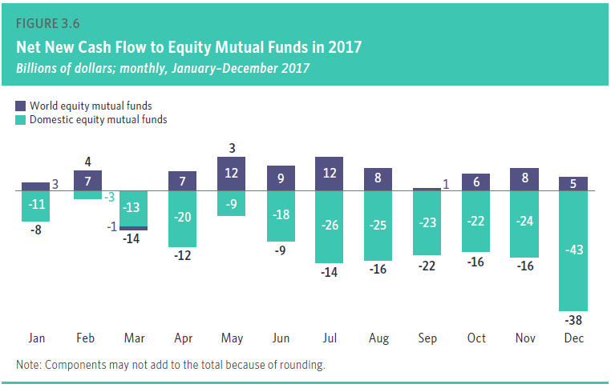
Recent Mutual Fund Trends

Slide 46
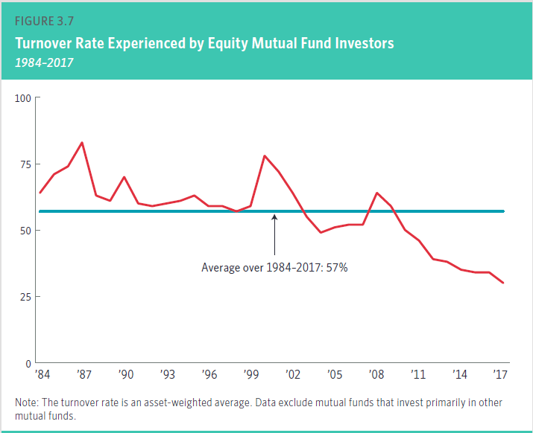
Recent Mutual Fund Trends

Slide 47
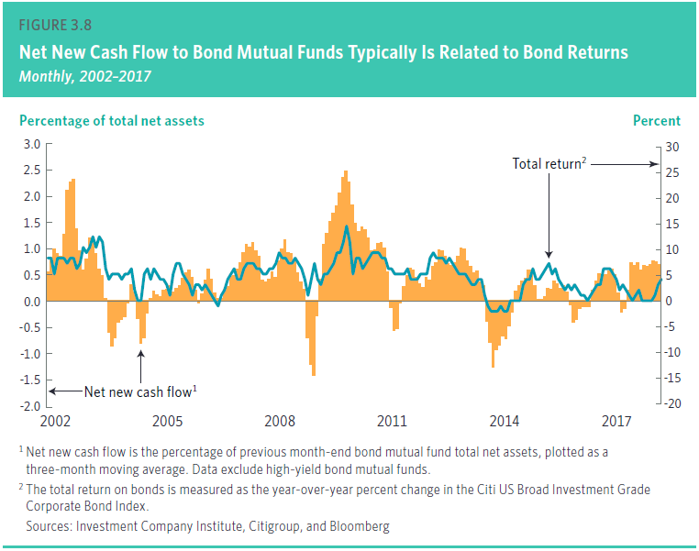
Recent Mutual Fund Trends

Slide 48
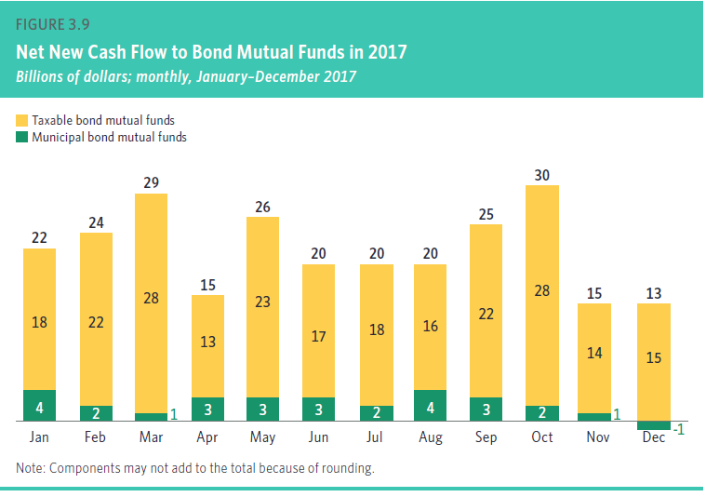
Recent Mutual Fund Trends

Slide 49
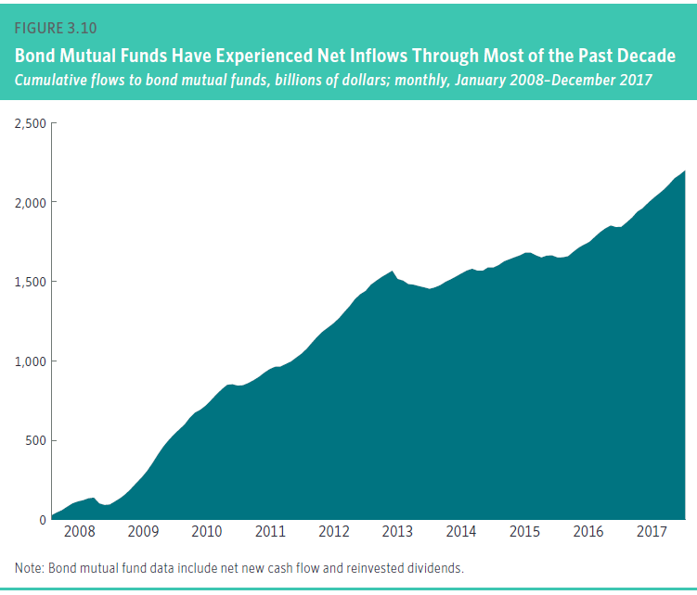
Recent Mutual Fund Trends

Slide 50
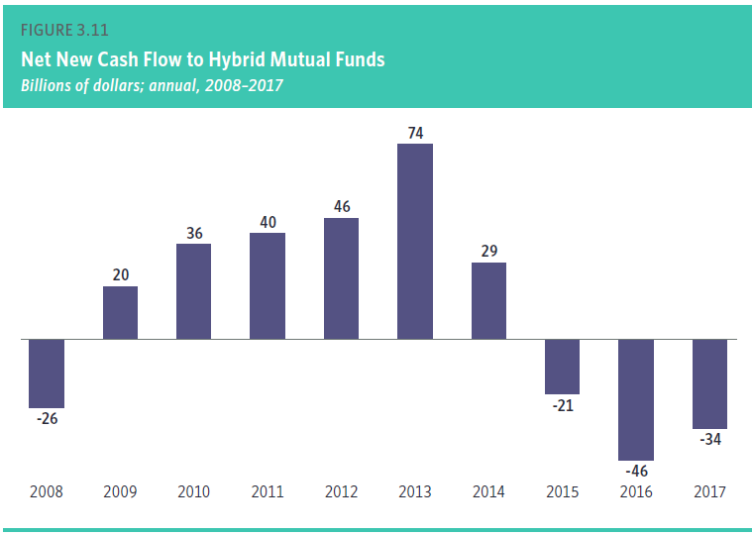
Recent Mutual Fund Trends

Slide 51
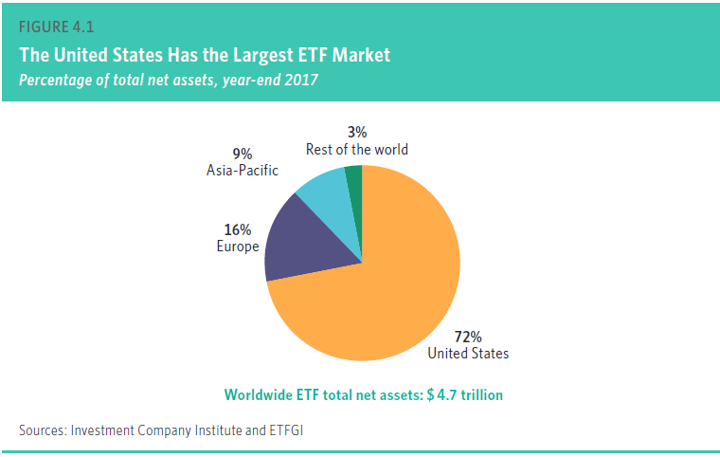
Recent Mutual Fund Trends

Slide 52
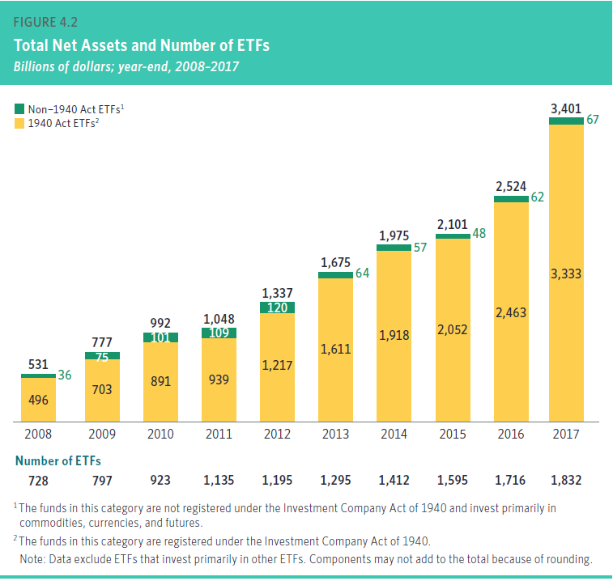
Recent Mutual Fund Trends

Slide 53
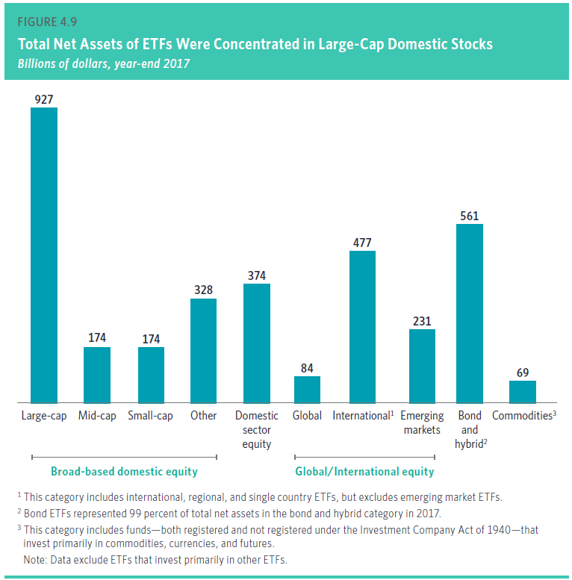
Recent Mutual Fund Trends

Slide 54
Session 3 Mutual Fund Types and Characteristics

Slide 55
Types of Funds
No matter what type of investor you are, there is bound to be a mutual fund that fits your style.
It's important to understand that each mutual fund has different risks and rewards.
By Structure
  Open Ended Schemes
  Close Ended Schemes
  Interval Schemes
By Investment Objectives
  Growth Schemes
  Income Schemes
  Balance Schemes
  Money Market Schemes
Other Schemes
  Tax Saving Schemes
Special Schemes
  Index Schemes
  Sector Specific Schemes

Slide 56
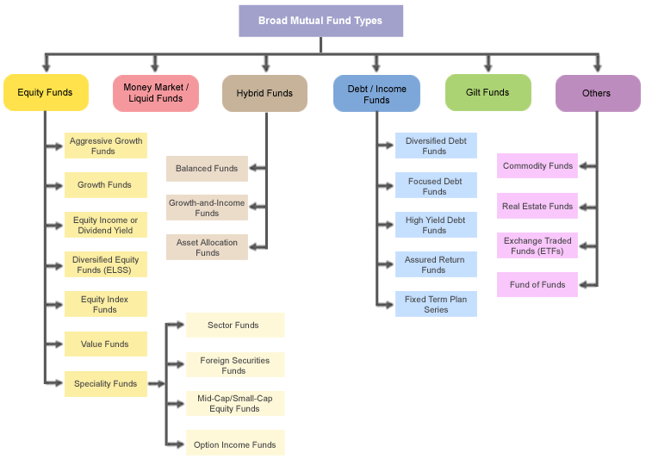
Classification of Mutual Fund

Slide 57
Open-end Funds
a. Investors buy and sell shares back to the fund itself
b. There is no limit on the number of shares the fund can issue
c. NET ASSET VALUE (NAV)
  Defined as the total market value of all securities held by the fund less liabilities, divided by the number of fund shares outstanding.
  NAV is calculated per the fund’s propectus
Example: NAV
  XYZ Mutual Fund owns assets totaling $10M and liabilities equal to $500,000 with 500,000 shares outstanding
  Therefore, NAV is:
  ($10,000,000 - $500,000) / 500,000
  $19/share

Slide 58
NAV
A mutual fund must calculate its NAV:
  Continuously
  Only once per day
  Weekly
  As stated in its prospectus

Slide 59
Automatic Reinvesting Dividends
What are the advantages for mutual fund investors in automatically reinvesting their dividends?
  Deferring income taxes
  The effects compounding
  Being able to purchase more shares with no sales charges
  Both b and c

Slide 60
Fixed-dollar systematic withdrawal plan
Under this withdrawal plan, the investor will receive the same amount of money every month until the funds in his account are exhausted.
Walker is liquidating his account at Spendthrift Funds. He is going to receive $1000 per month as long as the money in his account lasts. Walker is using:
  A fixed-dollar systematic withdrawal plan
  A fixed-shares systematic withdrawal plan
  A letter of intent
  Dollar cost averaging

Slide 61
Characteristics of Open-end Funds
An open-end investment company:
Continuously issues new shares to the public

Slide 62
Characteristics of Open-end Funds
Which of the following would NOT require a majority vote of a mutual fund's shares?
  Changing the fund from open-end to closed-end
  Changing the investment objectives of the fund
  Increasing the capital gain distribution paid by the fund
  Decreasing the dividend paid by the fund
  I and II only
  I and III only
  III and IV only
  I, II, III, and IV

Slide 63
Closed-end Funds
A fixed number of shares outstanding
Professionally managed
May be invested in equities, bonds, and other securities
573 Closed-end funds at year-end 2017
$275 billion market value
Shares sold at current market price
Trading on exchange market

Slide 64
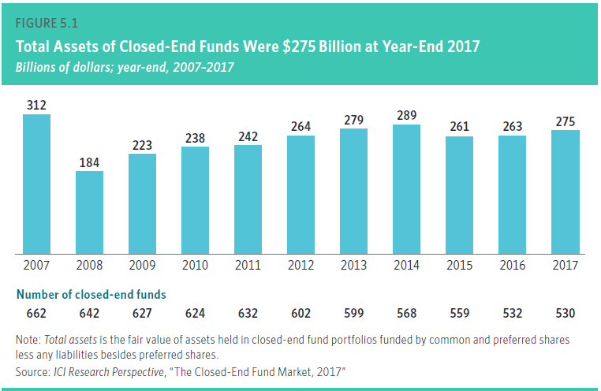
Closed-end Funds

Slide 65
Closed-end Funds
All of the following statements are true about closed-end investment companies EXCEPT that the:
  Number of outstanding shares is constant
  Shares are sold at the current market price
  Shares may not sell below the current net asset value
  Shares may be listed on the NYSE

Slide 66
Money Market Funds
Tax-exempt money market funds invest in securities that provide safety of principal, liquidity and income exempt from federal income taxes by investing in short-term, high-rated municipal obligations.
The money market consists of short-term debt instruments, mostly Treasury bills. This is a safe place to park your money. You won't get great returns, but you won't have to worry about losing your principal. A typical return is twice the amount you would earn in a regular checking/savings account and a little less than the average certificate of deposit (CD).

Slide 67
Money Market Funds
In-class exercise:
The portfolio of a money-market fund might contain all of the following securities EXCEPT:
  Treasury bills
  Negotiable CDs
  Preferred stocks
  Bankers’ acceptances

Slide 68
Money Market Funds
In-class exercise:
David is moving to Cancun in Mexico to start his exporting business. He has $300,000 that he is going to use for pay the company’s initial expenses over the next year. He wants to invest this money so that he can earn some interest on it, but he also needs to keep it liquid since he will be making frequent withdrawals. Which of the following funds would you recommend to David?
  A money-market fund
  A long-term U.S. government bond fund
  A growth fund
  An emerging markets fund

Slide 69
Fixed Income Funds
Those that invest primarily in bonds and preferred stocks are classified as fixed-income funds. These funds invest in corporate bonds or government-backed mortgage securities that have a fixed rate of return.
Bond funds are likely to pay higher returns than certificates of deposit and money market investments, but bond funds aren't without risk. Because there are many different types of bonds, bond funds can vary dramatically depending on where they invest. For example, a fund specializing in high-yield junk bonds is much more risky than a fund that invests in government securities. Furthermore, nearly all bond funds are subject to interest rate risk, which means that if rates go up the value of the fund goes down.
Gilt funds differ from bond funds because bond funds invest in corporate bonds, government securities, and money market instruments. Gilt funds stick to high quality-low risk debt, mainly government securities.

Slide 70
Municipal Bond Fund
Which of the following would most likely be the main investment objective of a municipal bond fund?
  Capital appreciation
  Tax-exempt income
  Speculation
  Long-term growth

Slide 71
Balanced Funds
The objective of these funds is to provide a balanced mixture of safety, income and capital appreciation. The strategy of balanced funds is to invest in a combination of fixed income and equities. A typical balanced fund might have a weighting of 60% equity and 40% fixed income. The weighting might also be restricted to a specified maximum or minimum for each asset class.
A similar type of fund is known as an asset allocation fund. Objectives are similar to those of a balanced fund, but these kinds of funds typically do not have to hold a specified percentage of any asset class. The portfolio manager is therefore given freedom to switch the ratio of asset classes as the economy moves through the business cycle.

Slide 72
Balanced Funds
Example:
Which of the following is the objective of a balanced Fund?
  Provide a balanced mixture of safety, income and capital appreciation
  Provide an aggressive growth on capital appreciation
  Provide a stable income
  Provide a conservation of the principal

Slide 73
Balanced Funds
In-class exercise:
ABC Fund always invests 10 to 20% of its portfolio in cash equivalents, 20 to 30% in bonds and 50 to 70% in preferred and common stocks. Although the exact proportion varies, the fund must always have some of its assets in each category. ABC Fund is an example of a(n):
  Asset allocation fund
  Balanced fund
  Conservative growth fund
  Index fund

Slide 74
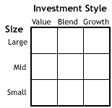
Equity Funds
Funds that invest in stocks represent the largest category of mutual funds. Generally, the investment objective of this class of funds is long-term capital growth with some income. There are, however, many different types of equity funds because there are many different types of equities. A great way to understand the universe of equity funds is to use a style box, an example of which is below.
These companies are characterized by P/E and price-to-book ratios and dividend yields.

Slide 75
Equity Funds
In-class exercise:
Amy and her husband just had their first child, David. They have $1,000 that they would like to invest for David’s college education. Which of the following funds would you recommend?
  A money-market fund
  A short-term U.S. government bond fund
  A municipal bond fund
  A diversified common stock fund

Slide 76
Global/International Funds
An international fund (or foreign fund) invests only outside your home country. Global funds invest anywhere around the world, including your home country.
What’s the key difference between an international fund and a global fund?
The funds do tend to be more volatile and have unique country and/or political risks.

Slide 77
Specialty Funds
Sector funds are targeted at specific sectors of the economy such as financial, technology, health, etc. Sector funds are extremely volatile. There is a greater possibility of big gains, but you have to accept that your sector may tank.
Regional funds make it easier to focus on a specific area of the world. This may mean focusing on a region (say Latin America) or an individual country (for example, only Brazil). An advantage of these funds is that they make it easier to buy stock in foreign countries, which is otherwise difficult and expensive. Just like for sector funds, you have to accept the high risk of loss, which occurs if the region goes into a bad recession.
Socially-responsible funds (or ethical funds) invest only in companies that meet the criteria of certain guidelines or beliefs. Most socially responsible funds don't invest in industries such as tobacco, alcoholic beverages, weapons or nuclear power. The idea is to get a competitive performance while still maintaining a healthy conscience.

Slide 78
Specialty Funds
A specialized or specialty fund invests in stocks that are primarily:
  In many industries
  In a particular industry or geographical area
  Traded in the OTC market
  Special situations

Slide 79
Index Funds
The last but certainly not the least important are index funds. This type of mutual fund replicates the performance of a broad market index such as the S&P 500 or Dow Jones Industrial Average (DJIA). An investor in an index fund figures that most managers can't beat the market. An index fund merely replicates the market return and benefits investors in the form of low fees.

Slide 80
Index Funds
A client would like to invest $500 a month and have broad exposure to the U.S. equity market. Which of the following recommendations would be the most suitable?
  A managed closed-end fund
  An S&P 500 Index mutual fund
  An S&P 500 Index Exchange Traded Fund
  An DJIA Exchange Traded Fund

Slide 81
Exchange Traded Fund (ETF)
Exchange-Traded Funds, or ETFs, are index funds that trade just like stocks on major stock exchanges.
Because it trades like a stock whose price fluctuates daily, an ETF does not have its net asset value (NAV) calculated every day like a mutual fund does.
By owning an ETF, you get the diversification of an index fund as well as the ability to sell short, buy on margin and purchase as little as one share.
Another advantage is that the expense ratios for most ETFs are lower than those of the average mutual fund. When buying and selling ETFs, you have to pay the same commission to your broker that you'd pay on any regular order.

Slide 82
Exchange Traded Fund (ETF)
A client wants to invest in a portfolio that is passively managed. Which two of the following will achieve this goal?
  A portfolio that invests only in fixed income securities
  An exchange traded fund based on the NASDAQ 100 Index
  A mutual fund that tracks the S&P 500 Index
  An account managed by an investment adviser
  I and III
  I and IV
  II and III
  II and IV

Slide 83

ETF

Slide 84
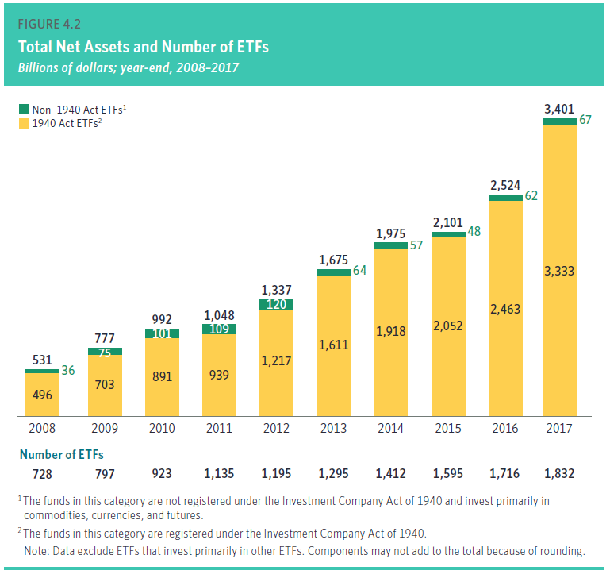
ETF

Slide 85
Additional Categories of Mutual Funds
Funds of Funds (FOFs)
  FOFs are mutual funds that hold and invest in shares of other mutual funds.
  Funds of funds are usually organized in a fund family of their own, offering funds that will specialize in international stocks, aggressive growth, income, and other objectives.
  The most popular type of these funds is hybrid funds - about 80 percent of fund-of-fund assets are in hybrid funds of funds. Hybrid funds of funds invest their net new cash in underlying stock, bond, and hybrid mutual funds.

Slide 86
Hedge Fund
A hedge fund is a private investment fund that charges a performance fee and is typically open to only a limited range of qualified investors
In the United States, in order for an investment fund to be exempt from direct regulation, it must be open to accredited investors only and only a limited number of investors can belong to it.
Because of an exemption from the types of regulation, hedge fund can invest in more complex and riskier investments than a public fund might.
the hedge fund manager will receive both a management fee and a performance fee.
The bulk of hedge funds exploit different market opportunities, use different techniques and different instruments:
  Style or strategy: global macro, directional, event driven, relative value (arbitrage), managed futures (CTA)
  Exposure: directional, market neutral
  Market: equity, fixed income, commodity, currency
  Instrument: long/short, futures, options

Slide 87
Special Services
1. Saving Plans
  Investor adds funds on a regular basis
2. Automatic Reinvestment Plans
  Dividends and capital gains are reinvested in additional shares
3. Regular Income
  Through withdrawal plans, the investor can receive periodic repayment or income
    Shares or Dollars
4. Conversion Privileges
  Allows the investor the right to switch from one fund to another
    a. Must confine switches within the same family of funds
    b. Usually no transfer charges

Slide 88
Costs
Fees can be broken down into two categories:
1. Ongoing yearly fees to keep you invested in the fund.
2. Transaction fees paid when you buy or sell shares in a fund (loads).
The Expense Ratio - The ongoing expenses of a mutual fund is represented by the expense ratio. The expense ratio is composed of the following:
  The cost of hiring the fund manager(s) - Also known as the management fee, this cost is between 0.5% and 1% of assets on average.
  Administrative costs - These include necessities such as postage, record keeping, customer service, cappuccino machines, etc.
  The last part of the ongoing fee (in the United States anyway) is known as the 12B-1 fee. This expense goes toward paying brokerage commissions and toward advertising and promoting the fund.
  On the whole, expense ratios range from as low as 0.2% (usually for index funds) to as high as 2%. The average equity mutual fund charges around 1.3%-1.5%. You'll generally pay more for specialty or international funds, which require more expertise from managers.

Slide 89
Costs
  Normally, the largest expense incurred by an open-end investment company is the:
  Sales charge reallowed to the broker-dealers
  Custodial fee
  Investment advisory fee
  Accountant's fee

Slide 90
12b-1 Fees
  12b-1 fees are used to pay the costs of distributing and marketing a
  fund. These costs include paying commissions to the registered
  representatives who sell the fund’s shares to the public.
  Among other things, 12b-1 fees are used to pay which of the following:
  Taxes
  Commissions
  Investment advisory fees
  Insurance

Slide 91
Load and No load
Front-end loads
  These are the most simple type of load: you pay the fee when you purchase the fund. If you invest $1,000 in a mutual fund with a 5% front-end load, $50 will pay for the sales charge, and $950 will be invested in the fund.
Back-end loads (also known as deferred sales charges)
  You pay the a back-end load if you sell a fund within a certain time frame. A typical example is a 6% back-end load that decreases to 0% in the seventh year. The load is 6% if you sell in the first year, 5% in the second year, etc. If you don't sell the mutual fund until the seventh year, you don't have to pay the back-end load at all.
No-load fund
  A no-load fund sells its shares without a commission or sales charge.

Slide 92
Mutual Funds Prospectus
Issue date and Issuer
Investment objectives
Strategies
Risk/Return
Fees and expenses
Past performance (return bar chart)
Managers/advisers/organization
shareholder service: reinvest, redemption

Slide 93
Mutual Funds Prospectus
Circular
Registration statement
Legal document
Investor protection
SEC standard formats
Section 10

Slide 94
Mutual Funds Prospectus
Expense – load, no-load, 12b -1 fees
  Load or No Load
    a. Load Fund
      Charges a commission when shares are bought (7 - 8 1/2% or more)
    b. No Load Fund
      No sales charges are levied
  Other fees and Costs
    a. Professional Management Fee
      .25 to 1.75 percent of the average dollar amount of assets under management
Expense Ratio
Turnover Ratio

Slide 95
Session 4 Mutual Fund Analysis

Slide 96
How to analyze a mutual fund
Assessment of your risk tolerance
The style of mutual fund
History performance of mutual fund

Slide 97
Assessment of Risk Tolerance
Risk Tolerance Group:
  Defensive - investors wish to eliminate all investment price volatility in favour of guaranteed security of their investment. 100% Defensive Assets
  Conservative - investors are willing to accept a measured amount of price volatility in expectation of slightly higher long-term returns. 80% Defensive Asset, 20% Growth Assets
  Moderately Conservative - investors are more comfortable with price volatility and are willing to accept the possibility of a modest loss in capital value in the medium-term. 60% Defensive Assets, 40% Growth Assets.
  Balanced - investors seek a higher level of growth and perhaps some tax effective returns from their portfolio, but they wish to have their growth assets ‘balanced’ by some defensive assets in order to manage the volatility of their total portfolio. 40% Defensive Assets, 60% Growth Assets
  Assertive - investors generally have had more experience in investing and understand and are willing to accept a higher level of price volatility when seeking higher returns. 20% Defensive Assets, 80% Growth Assets
  Aggressive - investors are generally experienced in investment markets and are willing to take a high level of risk in the short term when seeking high levels of long-term returns. 100% Growth Assets

Slide 98
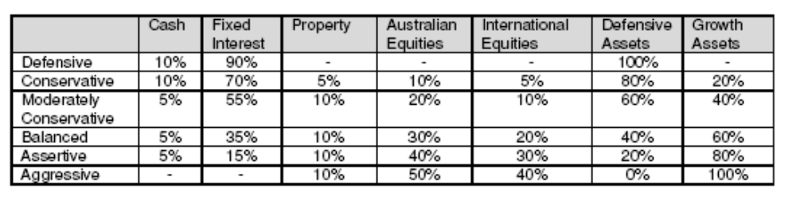
Assessment of Risk Tolerance
Indicative Portfolio
Risk Tolerance Assessment
  Questionnaire is used to risk tolerance assessment

Slide 99
Analyzing Mutual Funds
Style Analysis: Style analysis identifies the process of investing by fund managers that leads them to pick certain kinds of securities.
Three factors of style analysis:
  Growth
  Value
  Company Size

Slide 100
Analyzing Mutual Funds
Growth Managers buy stocks in companies whose earnings are growing rapidly.
Value Managers are bargain hunters seeking stocks with low prices compared to intrinsic value.
Company Size Managers specialize in small companies or large cos.

Slide 101
Mutual Fund Style Analysis
Style determines 85-90% of a fund portfolio’s return.
The technique looks at the way funds perform on a monthly basis against one of 12 different indexes. The mix of indexes that are most highly correlated determines the style of the mutual fund manager.

Slide 102
Mutual Fund Style Analysis
The mutual fund universe can be divided into six basic styles:
  Small cap growth funds
  Large cap growth funds
  Small cap value
  Large cap value
  Foreign funds
  Fixed income funds

Slide 103
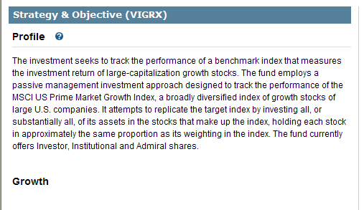
Vanguard Growth Index Inv (VIGRX)

Slide 104
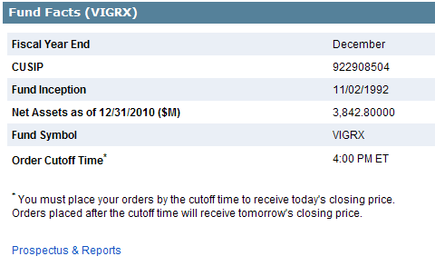
Vanguard Growth Index Inv (VIGRX)

Slide 105
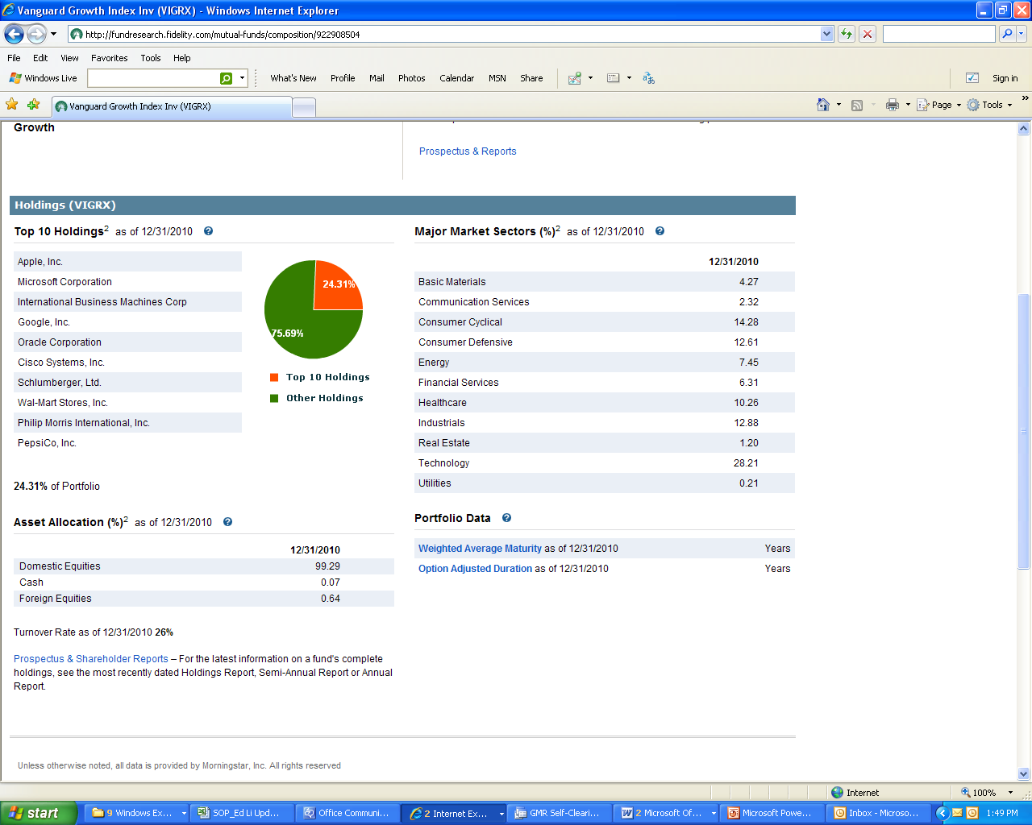
Vanguard Growth Index Inv (VIGRX)

Slide 106
Vanguard Growth Index Inv (VIGRX)

Slide 107
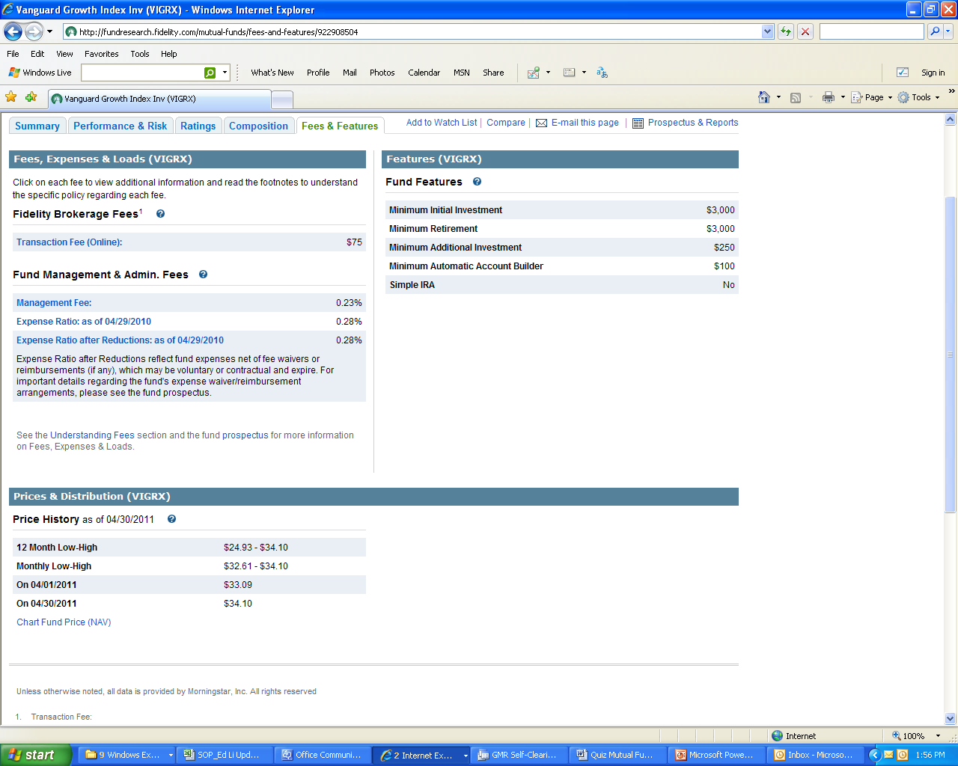
Vanguard Growth Index Inv (VIGRX)

Slide 108
Vanguard Growth Index Inv (VIGRX)

Slide 109
Vanguard Growth Index Inv (VIGRX)

Slide 110
Mutual Fund Style Analysis
In-class exercise:
The ABC Fund invests primarily in the stocks of small-cap companies, particularly companies that have just gone public for the first time. What type of fund is it?
  Money-market
  Fixed income
  Aggressive growth
  Balanced

Slide 111
Mutual Fund Style Analysis
In-class exercise:
Here are the top 4 holdings of the High Returns Stock Fund.
    Big-Blue Computers
    Orange Computers
    Semiconductor Manufacturer
    Macrohard Software
Based on this information, the High Returns Fund is probably an example of which of the following types of funds?
    Money-market fund
    Sector fund
    Emerging market fund
    Tax-exempt fund

Slide 112
Mutual Fund Annual Report
Two Reports a Year: Mutual funds typically issue two financial reports a year - the semiannual report, which is often dated June 30 or April 30, and the year-end or annual report, which is often dated December 31 or October 31.
Shareholder Letter: A shareholder letter is usually written by the fund’s president or investment manager and reviews the fund’s investment objectives and performance for the current period.
Top 10: By looking at a mutual fund’s top 10 holdings, you will get a sense of the type of investments in the portfolio and the degree to which the fund meets your investment objectives. Similarly, study the industry composition of the portfolio - the percent of the fund’s asset that is invested in a particular industry.

Slide 113
Mutual Fund Annual Report
Investment Portfolio: An investment portfolio comprises the assets (securities) held within a mutual fund.
Portfolio Turnover: Portfolio turnover is the percentage of the portfolio’s investment that are bought and sold in one year. A fund with a portfolio turnover rate of 100 percent means they effectively bought and sold every security in the portfolio. High portfolio turnover increases transaction expenses and often reduces your rate of return.
Charts and Graphs: Many mutual fund reports include charts and graphs. A line graph may compare the growth of a $10,000 investment in the fund to the growth of similar investments over five years, ten years, or over the life of the fund. Pie charts are used to show the % of each type of investment in the fund: C.S., bonds, and cash.

Slide 114
Mutual Fund Annual Report
Portfolio: Some mutual fund financial reports include a more in-depth discussion of the fund’s performance for the period than the shareholder’s letter.
Statement of Assets and Liabilities: A mutual fund’s statement of assets and liabilities reflects the fund’s financial position at the stock or bond market’s close on the date of the report. Assets typically include investments that are valued at market on the financial statement date. Other assets include collateral held for securities loaned and receivables. Two examples are dividends and interest income receivable, which represent income earned by the fund but not yet collected in cash. Liabilities primarily represent amounts the fund owes for the purchase of new securities.

Slide 115
Mutual Fund Annual Report
Footnotes to the Financial Statements: Mutual fund financial reports include footnotes similar to those found in other annual reports. Footnotes include significant accounting policies, and related party and affiliate transactions.
Significant Accounting Policies: Related party and affiliate transactions typically include three types of transactions. The first occurs when payment of fees is made to portfolio managers and financial advisors. The second occurs when a mutual fund accumulates an ownership stake of a least 5% of the company. The third occurs when one mutual fund sells some of its investments to another mutual fund sponsored by the same mutual fund family.

